Slide 1
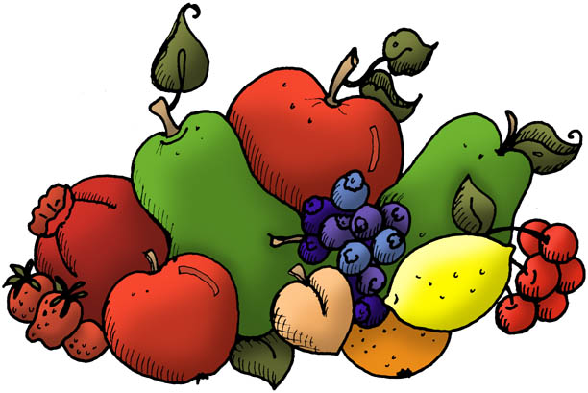
Chapter 9
Fruits and Vegetables

Slide 2
What is a fruit?
An organ that develops from the ovary of a flowering plant and contains one or more seeds.
Or
The perfect snack food, the basis of a dessert, colorful sauce or soup or an accompaniment to meat, fish, or poultry.

Slide 3
What is fruit sugar called?
Fructose

Slide 4
Fruits are classified.
Classified by growing season and location.
Summer Fruit
Winter Fruit
Tropical Fruit

Slide 5
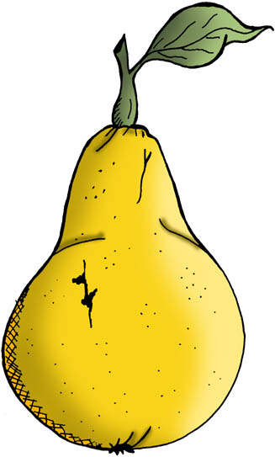
Summer Fruits
Berries, cherries, grapes, melons, peaches, plums and pears.
Single stone fruit is a drupe
Most are delicious raw, also popular baked or cooked.

Slide 6
Berries
Most perishable, tender and fragile
Handle as little as possible
Don’t wash until used
Technically grapes are berries

Slide 7
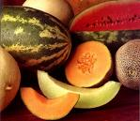
Melons
Cantaloupe
Crenshaw
Honeydew
Watermelon
From the squash
family

Slide 8
Winter Fruits
Citrus such as oranges, grapefruits, lemons, limes, tangerines
Citrus fruits are high in vitamin C. Limes have more than oranges or lemons.
Apples are winter fruits even though they begin coming in during the fall. In cold storage, apples can last for months.

Slide 9
Tropical Fruits
Named for climate in regions where they grow.
Includes figs, dates, bananas, papayas, pineapple, pomegranates and passion fruit.

Slide 10
Vegetables
Edible herb-like plant.
Leaves, fruit, stems, roots, tubers, seeds & flowers

Slide 11
Flower Vegetable
Includes broccoli, cauliflower, Brussels sprouts and cabbage.
They are the flower of the plant.
Squash blossoms can be stuffed and fried as a vegetable.

Slide 12
Fruit Vegetables
Avocados (used to make guacamole), cucumbers, eggplants, peppers, squash & tomatoes.
Fruit of the plant – from a flower.
Defined as a fleshy covering surrounding seeds of the plant.

Slide 13
Leafy Vegetables
Includes lettuce, spinach, winter greens (turnip, kale and mustard) and Swiss chard.
Common lettuce varieties include: Iceberg, Romaine, Bibb, Green Leaf, Red Leaf and Boston.

Slide 14
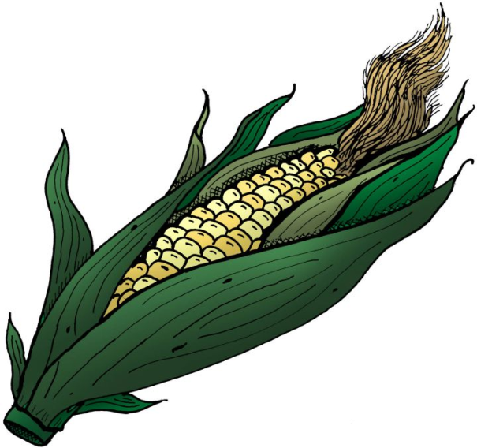
Seed Vegetable
Vegetable in which the seed, and/or pod of the plant is eaten. Corn, peas, beans.

Slide 15
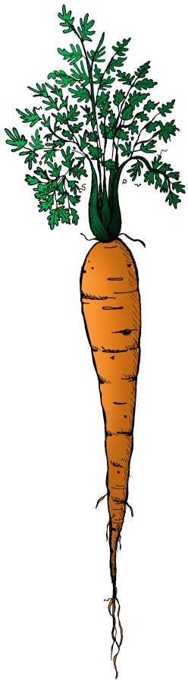
Root Vegetable
Vegetable that has a single root that extended into the ground and provides nutrients to the part of the plant that exists above ground. Carrot, radish.
When they get old, root vegetables sprout roots.

Slide 16
Tubers
Potatoes & sweet potatoes.
Bulbous root capable of generating a new plant.
Grows underground.
When they get old, tubers sprout stems and leaves to form the new plant.

Slide 17
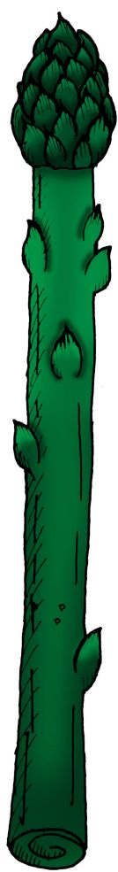
Stem Vegetables
Vegetable in which the fibrous plant stem is eaten.
Celery, asparagus, artichokes & mushrooms.

Slide 18
Fruit How-To
Unripe fruit should be stored at room temperature (65-75F) to ripen.
Placing fruits in a paper bag can speed ripening.
Ripen bananas by placing them with apples or pears.
Store ripe fruit in fridge to prolong life.
Fresh produce (fruits or vegetables) can generally be stored about 4 days.

Slide 19
Storing Fruits and Vegetables
Roots and tubers: dry, unpeeled in a cool dark area. Under the sink is a favorite place.
Ripe fruits and vegetables: in refrigerator with humidity of 80-110% Fruits in one drawer, vegetables in another. Some fruits emit ethylene that causes fruits to ripen.
Remove tops from carrots, turnips etc. The tops pull moisture and nutrients from the roots and speed spoilage.
Unripened fruits and vegetables: room temperature until ripe, then refrigerator.

Slide 20
Summarize ways to prevent fruits and vegetables from spoiling too quickly.
Keep fruits and vegetables away from each other.
Refrigerate if ripe.
Limit storage life.
Don’t peel or wash before use.
Only store about 4 days.

Slide 21
Appropriate cooking methods for fruit
Grill or broil
Poach
Sautee
Bake
Microwave
Cook Quickly – Slices, chunks or halves Pineapple, Bananas, Peaches
Firm fruit – Apples, peaches, pears half or large pieces…small fruit keep whole.
Peel, core and seed, cut in uniform size – cherries, bananas, pears, pineapple
Firm fruit – whole or large pieces, apples, pears and bananas
Watch cooking time, cover – pierce skins with a fork to prevent bursting.

Slide 22
Explain how to prevent enzymatic browning of fruits.
When oxygen comes in contact with flesh of cut fruit and turns it brown.
Coat with acid like lemon juice as soon as they are cut.
Holding in water can work short term.

Slide 23
Match vegetables to appropriate cooking methods.
Boiling
Steaming
Microwaving
Roasting & Baking
Sautéing
Deep-frying
Grilling
Artichokes, asparagus, green beans, broccoli, carrots & potatoes
Mushrooms & onions
Most vegetables
Carrots, cauliflower, potatoes & zucchini
Corn, potatoes, cabbage & carrots
Squash, eggplant, mushrooms & potatoes
Asparagus, mushrooms, onions, corn & eggplant

Slide 24
Some Random Bits
Hydroponic farming is a way to have fresh vegetables year round.
Plants are grown in nutrient enriched water in greenhouses where light and temperature can be controlled.
Dried plums are marketed as Prunes. But prunes got a bad reputation because they can help you go to the bathroom if you’re constipated.
So now the prune people are marketing them as dried plums.

Slide 25
More Random Bits
Cooks can tell when a vegetable is done cooking by its appearance and its texture.
Vegetables are often cut into small cubes with a chef’s knife. This cut is called a dice.
Herbs and garlic are often cut into the smallest possible pieces, so their flavor can be distributed throughout a dish.
This is called mincing.

