Slide 1


ProStart
Obj. 7.0
Communication

Slide 2

The Process of Communication
Communication
  The process of sending and receiving information by talk, gestures, or writing for some type of response or action.
  Verbal
    Speaking and writing
  Nonverbal
    Body language and gestures
      Body Language Exercise
  Effective Communication
    A learned skill
7.1
Chapter 7 | Communication

Slide 3
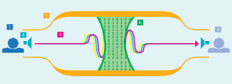
The Process of Communication
Understanding how the communication process works is important for building strong relationships with employees and customers.

Slide 4
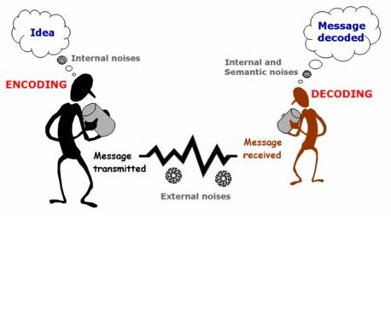
The Process of Communication
The communication process has five parts:
  Example of how it would be in a foodservice industry
    Sender (Chef),
    Receiver (Line Cook),
    Message content (Fire 3 shrimp on table 10),
    Message channel (Downward), and
    Context (The line cook is “in the weeds”, and the chef really needs that table out quickly).

Slide 5
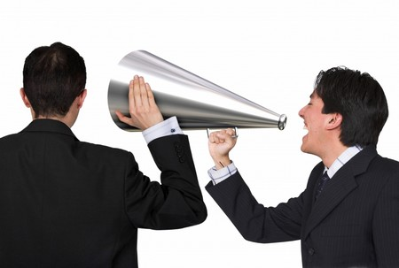
The Process of Communication
The two kinds of messages are:
  Historical information: This is information that has already happened.
  Action-required information: Some action must be taken based on the information in the message.
Messages can take many forms
  Words
  Sounds
    Sirens
  Graphic illustrations
    Pictures
  Signs and symbols

Slide 6
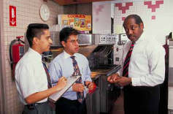
Barriers to Communication
Lack of time
Barriers to communication
  Anything that interferes or affects communication
    Include lack of time and other pressing needs
    Fear of confrontation
  Who's on First?
To prevent barriers in communication, make a plan:
  Before sending a message, observe the audience.
  Decide the best way to get the message out with a chance of success.
  Make sure the message was successfully received.
Fear of confrontation
Different cultural backgrounds
7.1
Chapter 7 | Communication

Slide 7
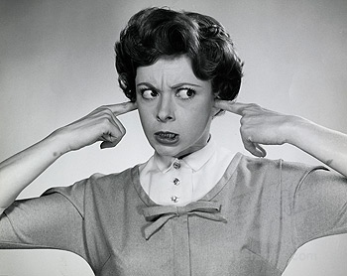
Barriers to Communication
Language Differences
  Accent is concerned with the way you sound when you speak. Southern English is an accent. You can have a New York accent or a mid-Western accent.
  Dialect: a regional variety of a language, with differences in vocabulary, grammar, and pronunciation
    Hoagie vs hero or sub sandwich is dialect
    Southern y’all vs. New York’s yous guys is dialect.
    Dialect can interfere with understanding people from other regions.

Slide 8
Communication
  Semantics is all about the meaning of words and how words work together to create meaning.
    What you think words mean
      What do you use to pare a pair of pears?
      Mouse
      Rodent or computer device?
  Noise – stuff that interferes with communication. It could be background noise or someone who goes on and on and on and never gets to the point.
  Nonverbal boundaries – your personal space.
  Gestures – pointing and waving, crossing arms etc. The test test includes “smiling and yelling” under gestures. Go figure.

Slide 9
Barriers to Communication
Jargon
  the language peculiar to a particular trade, profession, or group
    Like “outside the box” from advertising or “in the weeds” from foodservice.
Slang
  the use of words and expressions that are not considered standard
  “ain’t, what’s up, whaddayaknow”
Tone of message
  Tone is the feeling that can be heard in your voice.
  Avoid negativity and sarcasm to sound sincere
Clarity (the most important part of a message)
  “I can’t recommend this dish too highly.” Does this make sense. Just say – “I recommend this dish highly; it’s my favorite.”
Assumptions (can get you in trouble)
  Assuming that someone knows how to solve the problem
Cultural differences
  Biscuits can be a:
    Bread, Cracker, or Cookie
Prejudices and biases
  Preconceived idea about a specific group.
    “Teenagers are lazy.”
    “Older people are computer illiterate.”

Slide 10

Personal Characteristics That Affect Communication Skills
Communicating is not just about writing or speaking.
  Personal characteristics, such as body language,
  eye contact, and
  credibility, have a major impact on communication between people.
Whenever communicating with supervisors, coworkers, classmates, or customers whose backgrounds are different, be aware of their reactions.
  Misunderstanding
  Body Language
7.2
Chapter 7 | Communication

Slide 11
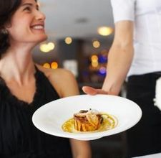
Personal Characteristics That Affect Communication Skills
In a restaurant or foodservice operation, it is important that guests find the staff to be credible during communication.
  Credibility is the ability of a person to be believed.
    For servers, product knowledge is important to credibility.
    When a guest complains about something, the credibility of the server or manager who handles the complaint is critical to good communication.
    Chefs must have knowledge of processes and procedures to be credible.

Slide 12
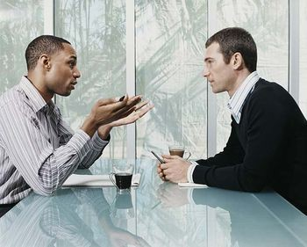
Effective Listening
Listening
  The ability to focus closely on what another person is saying to summarize the true meaning of a message.
  A learned skill
    It takes practice!
How to be a good listener.
Listening is vital to communication because if the message is not received by the listener – no real communication has taken place.
7.2
Chapter 7 | Communication

Slide 13
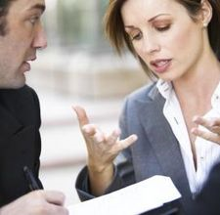
Effective Listening
An effective listener actively participates in the communication process.
  To be an effective listener, follow these guidelines:
  Prepare to listen.
    Stop talking and focus on the other person.
  Show that you’re paying attention.
    Eye contact
    Nodding while someone is speaking
    Leaning towards the person speaking
    Facial expressions
  Don’t interrupt and don’t finish the other person’s sentences in your mind or aloud.
  Ask questions to clarify.
  Listen between the lines.
    Repeat what you have heard.
  Don’t overreact.
  Record key ideas and phrases.
    Notetaking

Slide 14

Effective Speaking
When planning a message, deliver the key points in a brief and clear manner.
To ensure that the communication has covered all the vital information, answer the five “W’s” and “How” questions:
  Who?
  What?
  When?
  Where?
  Why?
  How?
Develop the communication further and think about how the audience will respond to the message.
  Consider ways to personalize or customize it for them.
7.2
Chapter 7 | Communication

Slide 15

Effective Speaking
Qualities of an Effective Speaker
  Interact with the audience
    Josh Shipp
  Use suitable language
  Use appropriate nonverbal communications
  Vary your speech patterns
    Bueler
  Close the conversation

Slide 16
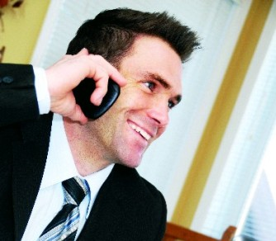
Effective Telephone Skills
You must be both an effective listener and an effective speaker:
  State the name of the organization, followed by the call receiver’s name, and the question, “How may I assist you?”
  Listen for the reason the caller has phoned the organization.
  Maintain a positive, polite, and courteous attitude when speaking with the caller.
  If the caller has a large amount of information, take notes to be sure all the information is received.
    Ask the 5 W’s
7.2
Chapter 7 | Communication

Slide 17
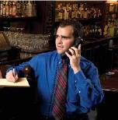
Effective Telephone Skills
  Paraphrase or repeat what the caller has stated.
After listening to what the caller has to say, decide whether you can resolve the caller’s problem.
If you can resolve the caller’s concerns, explain to the caller any steps to be taken.
Close the conversation either by explaining to the caller that you’ll be transferring him or her or asking whether there is anything else you can do to assist him or her.
Write messages down on a pre-printed message form.
Always end the conversation on a positive note.

Slide 18

Effective Telephone Skills
Guidelines
  Never put a caller on hold without first asking for permission.
  If on hold, get back to them ASAP (within 60 seconds).
  If they’ve been on hold longer than 60 seconds, offer to take a message.
  Don’t have a side conversation while someone is on the phone.
    They may hear what you are saying on the phone.

Slide 19
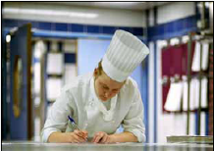
Effective Writing
Written business communication is another means for a manager to share information.
  Memos, faxes, emails, letters, and reports
  Have a more formal structure
    Introduction – gets audience’s attention and tells about what you will say.
    Body of the message – purpose is to deliver the content of the communication.
    Conclusion – sums up, identifies the value of the message. Make it sound like you’re done.
To write a successful message, the communicator needs a strong process that helps him or her to plan what to say and builds the message’s structure.
7.2
Chapter 7 | Communication

Slide 20
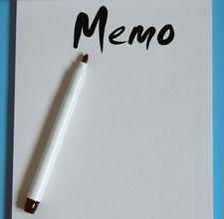
Effective Writing
Written communication pointers:
  Be brief.
  Be clear and complete.
  Review writing to be sure ideas are understandable and comprehensive.
  Keep it simple.
  Check your work.
  Always write with an upbeat attitude.
  Take a timeout.
  Read out loud to check grammar and punctuation.
  Don’t use slang, or “text-ese” or text message lingo.

Slide 21
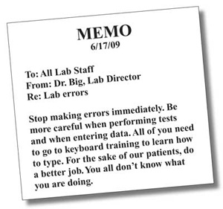
Effective Writing
Examples of Good and Bad Memos
  p. 435
Use of Technology to Communicate
  Make sure the person receiving the message can understand and act upon it.
    When Parents Text
      MOM: nine one one nine one one nine one one. call me now.
      ME: Why do you spell out the numbers?
      MOM: I dont know how.
      Me: Going to see twilight!! Be home at 11:30.
      Dad: Olajuwon.
      Me: ????
      Dad: I thought I said okay.

Slide 22

Effective Writing
Beware of common pitfalls
  Lack of planning
  Lack of purpose
  Forgetting the audience
  Use of incorrect style

Slide 23
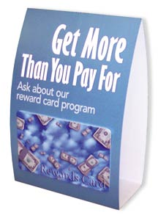
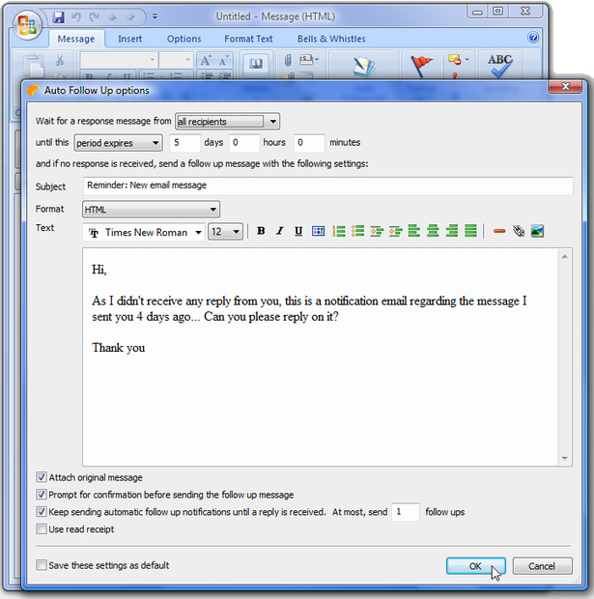
Organizational Communication
Organizational communication
  The numerous messages and information that convey operational procedures, policies, and announcements to a wide variety of audiences.
  Sent to people inside the organization or outside the organization.
    Inside: Email sent stating a change in the dress code
    Outside: Table tent for guests to read that outlines the new sustainable practices in the operation.
7.3
Chapter 7 | Communication

Slide 24

Organizational Communication
Two important types of organizational communication are the mission statements and vision statements of an operation:
  Mission statement
    An internal function (inside company only; not to public or customers)
    Describes the company’s purpose and key objectives to its team and owners.
  Vision statement
    Both internally and externally (goes out to customers and may be used in advertising).
    Defines the company’s purpose and values to employees and customers.
Other high priorities for organizational communication include industrial, environmental, and community-related issues.
  Ex: Construction issues should be communicated in a timely manner so guests are not inconvenienced.
  Ex: Pollution reduction—no smoking ordinances

Slide 25
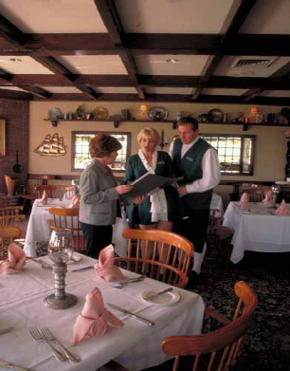
Interpersonal Communication
Interpersonal communication is any two-way communication that has immediate feedback.
Key to creating a positive and respectful work environment.
Interpersonal communication occurs in all types of relationships.
The goals of interpersonal communication
  to achieve a specific outcome
    Provide performance feedback
  to improve the relationships of the people involved.
7.3
Chapter 7 | Communication

Slide 26
Interpersonal Communication
In interpersonal communication, one person shares information that helps the other person relate back.
  By sharing, the two become closer and strengthen their relationship.
    Remember, “actions speak louder than words”.
      Are they humble?
      Do they praise others?
      Do they remain professional at all times?
Feedback is any communication that helps
a person understand how well he or she has
done something and how he or she can
Improve.
7.3
Chapter 7 | Communication

Slide 27
Interpersonal Communication
Verbal messages have a significant impact on interpersonal communication, and, therefore, on the relationships a manager has with employees.
Empathy
  Act of identifying with the feelings, thoughts, or attitudes of another person.
    “Walking in someone else’s shoes”
Interpersonal communication allows managers to model an organization’s values to employees.
Successful managers use all the available and appropriate ways to communicate with staff and coworkers.
  Build a friendly environment
    Chatting with employees
    Nonverbal cues
      Thumbs up, pat on the back, etc.
  Feedback
    Employee report card
      Respect their feelings

Slide 28
Random stuff on the test
In Japan, in certain Native American tribes, direct eye contact is avoided. It is considered aggressive and rude.
In China, winking is rude.
In some South American countries the O.K. symbol is like the middle finger and thumbs up is rude.
Smile when you are on the phone. It makes your voice sound more pleasant.
Write handwritten communication on ivory or white notecards.
People spend about 75 percent of each day communicating in some fashion.

