Slide 1


Chapter 1
Welcome to the Restaurant and Foodservice Industry

Slide 2

Overview of the Restaurant and Foodservice Industry
Characteristics of the Restaurant and Foodservice Industry:
Annual sales of over $550 billion dollars.
More than 945,000 restaurant and foodservice operators.
Employs more than 13 million people.
Over 57 percent of restaurant and foodservice managers are women.
Approximately 25 percent of eating-drinking establishments are owned by women, 15 percent by Asians, 8 percent by Hispanics, and 4 percent by African Americans.
The industry expects to continue to grow over the next decade, with 14.8 million jobs by 2019.
1.1
Chapter 1 | Welcome to the Restaurant and Foodservice Industry

Slide 3
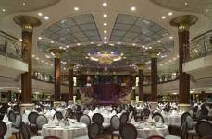
The Restaurant and
Foodservice Industry
The restaurant and foodservice industry can be divided into two major parts or segments: commercial and noncommercial.
Commercial
  The commercial segment makes up almost 80 percent of the restaurant and foodservice industry.
  Types of foodservice within the foodservice segment include restaurants, catering and banquets, retail, stadium, and airline and cruise ships.
Noncommercial
  The noncommercial segment represents about 20 percent of the foodservice industry.
  The noncommercial segment prepares and serves food in support of some other establishment’s main function or purpose.
  Categories in this segment include schools and universities, military, health care, business and industry, and clubs.
1.1
Chapter 1 | Welcome to the Restaurant and Foodservice Industry

Slide 4

The Big Picture: The
Hospitality Industry
Combination of all of the services that people need and will pay for when they are away from home. (Ex: transportation, lodging, and dining.
Travel and Tourism
Services that people use and receive when they are away from home (Dining and lodging)
Hospitality
Event Planning
Lodging
Food Service
1.1
Chapter 1 | Welcome to the Restaurant and Foodservice Industry

Slide 5
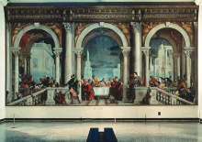
The History of Hospitality and Foodservice
The Real Beginning: Ancient Greece
  Ancient Greeks rarely dined out, although they enjoyed the social aspect of dining and often got together for banquets.
    Lesche
      Private clubs that offered food to members
    Phatnai
      Establishments that catered to travelers, traders, and visiting diplomats
    Reclining on couches, enjoying music, poetry, and dancing.
Rome: (Roman empire was based in Italy in the city of Rome)
  Romans’ meals were primarily served in the home.
  Romans’ desires for exotic foods and spices increased trade, stretching the Roman Empire farther east and north.
    France, Germany, England, Spain, and Portugal
1.1
Chapter 1 | Welcome to the Restaurant and Foodservice Industry

Slide 6
The History of Hospitality and Foodservice
The Middle Ages:
  Change from a nomadic society to farming society
    Loss of specific religious beliefs allowed for usage of the land
  Feudal society
    Landowners, who lived in relative comfort, held large banquets almost every night.
  Travel was extremely dangerous. After the Moors invaded Spain in 800 AD, trade with the Far East and India came to a stop— including the shipment of spices and fine goods.
    Europe remained isolated from the rest of the world for 200 years.

Slide 7
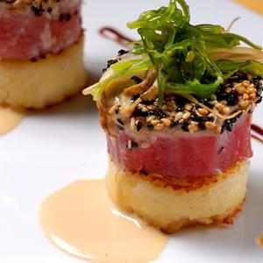
The History of Hospitality and Foodservice (cont.)
The Renaissance through the French Revolution:
  During the Renaissance, world travel and international trade greatly improved the European way of life.
  The food preparation system we now call haute cuisine.
    An elaborate and refined system of food preparation, had its roots during this period.
1.1
Chapter 1 | Welcome to the Restaurant and Foodservice Industry

Slide 8
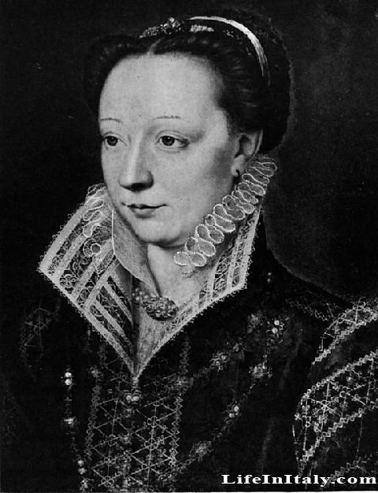
The History of Hospitality and Foodservice (cont.)
Did you know…
  Middle Ages silverware
    Made of wood or horn, but often people ate with their hands
    Only the wealthy could afford silverware
  Renaissance
    Catherine de Medici of Italy started using silverware in 1533 when she married King Henry II of France
      Brought her entire staff of cooks and refined recipes to French court (Birth of French cuisine)

Slide 9
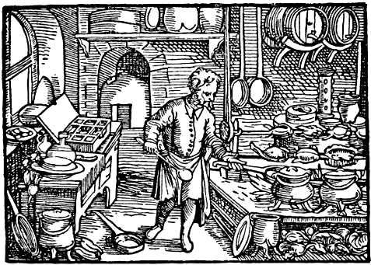
The History of Hospitality and Foodservice (cont.)
International trade greatly improved the European way of life.
  Introduction of coffee from Africa
    1650—1st coffee house, café, opens in Oxford, England.
      Open to women unlike the pubs and ale houses
  Guilds
    Associations of people with similar interests or professions, were organized.
      Each guild controlled the production of its specialties and could prevent others from making and selling the same item.
        Chaine de Rotissieres (roasters)
        Chaine de Traiteurs (caterers)
    Cooking guilds established many of the professional standards and traditions that exist today.

Slide 10

The History of Hospitality and Foodservice (cont.)
In 1765,
  a man named Boulanger began serving hot soups called restaurers (meaning restoratives) for their health-restoring properties.
  He called his café a restorante, the origin of our modern word restaurant.
French Revolution
  Once over, large numbers of cooks and other guild members found themselves unemployed.
  They followed Boulanger’s example and began opening restaurants of their own.
    Within 30 years, Paris had over 500 restaurants serving meals.
      Dining out on a large scale is born!

Slide 11
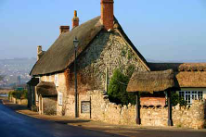
The History of Hospitality and Foodservice
Colonial North America
  As people immigrated to the New World, cities along the East Coast grew.
    Boston and New York became major centers of trade.
  As early as 1634, an inn in Boston called Cole’s offered food and lodging to travelers.
  Very few early-colonial Americans ever traveled or dined out.
    Didn’t travel more than 25 miles from home once settled.
    Those people who did travel, stayed at inns,
      often sleeping together in the same large room and even sharing a single bed.
      If travelers arrived after dinner had been served, they would have to go without.
        1794—The City Hotel, first building in the US designed specifically as a hotel.
1.1
Chapter 1 | Welcome to the Restaurant and Foodservice Industry

Slide 12
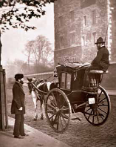
The History of Hospitality and Foodservice (cont.)
The Industrial Revolution:
  During the Industrial Revolution, people moved to the city to find work in the growing number of factories to earn a better living.
    Industrial Revolution
  People needed to live close enough to the factory to walk to work, go home for lunch, and leave again for dinner.
    Invention of diners.
  As cities became business hubs, dining and lodging establishments opened up to serve the needs of workers and employers.
  With the invention of the railroad in 1825, inns, taverns, and foodservice facilities located near railway stations began to grow.
1.1
Chapter 1 | Welcome to the Restaurant and Foodservice Industry

Slide 13
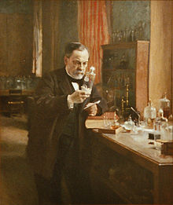
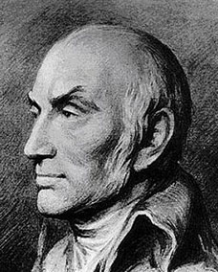
The History of Hospitality and Foodservice (cont.)
Did You Know…
  Scientific Revolution
  Louis Pasteur
    Pasteurization
      Made milk safer to drink by heating it to a certain temperature to destroy harmful bacteria.
  Nicolas Appert
    Canning
      Found a way to keep food fresh and safe to eat

Slide 14
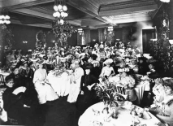
The History of Hospitality and Foodservice (cont.)
The Gilded Age:
  The idea of a less valuable product lightly covered with gold.
    Socially: Workers were subjected to long hours at low wages while the profits for the owners continued to rise.
  In the late nineteenth century, when high society dined out, they did so in style so that they could be seen in elegant surroundings.
    Delmonico's
      Dinners of up to 18 courses were not uncommon!
1.1
Chapter 1 | Welcome to the Restaurant and Foodservice Industry

Slide 15
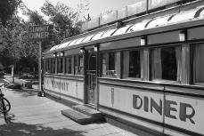
The History of Hospitality and Foodservice (cont.)
  As a result of the California gold rush (1848–1855), people who hit the jackpot wanted to enjoy the fine dining that they knew existed in New York with their newfound wealth.
  For the thousands of less fortunate individuals, meeting the demand to feed them was nearly impossible. Clever restaurateurs developed the cafeteria.
    An assembly-line process of serving food quickly and cheaply without the need for servers.

Slide 16
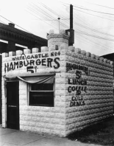
The History of Hospitality and Foodservice (cont.)
The Twentieth Century:
  By the turn of the century, more people were working and therefore eating out more, especially for lunch.
    Birth of Quick-Service Restaurants
      1921—1st White Castle restaurant opens in Wichita, Kansas.
  During World War II in the 1940s, the lodging industry prospered as people traveled for war-related reasons.
1.1
Chapter 1 | Welcome to the Restaurant and Foodservice Industry

Slide 17
The History of Hospitality and Foodservice (cont.)
  After World War II, in the 1940s and 1950s, the quick-service restaurant segment of the industry grew quickly.
    McDonald’s, KFC, etc.
      Guaranteed a specific level of quality, taste, food safety, and price
      High volume + lower costs = Profit $$
  In the 1960s, transportation technology and commercial air travel became popular, and builders focused on land near airports as the next new place to situate hotels, motels, and foodservice facilities.
    Cars--Route 66

Slide 18
The History of Hospitality and Foodservice (cont.)
The Twentieth Century (continued):
  The rapid growth of national chains from the 1970s to today has changed the face of the restaurant and foodservice industry.
  “Eating out” became almost as commonplace as eating at home—not just for special occasions, but simply for convenience.
  In the last few decades, lifestyles have moved steadily toward busier households that no longer have a dedicated daily food preparer. Large restaurant chains lead the way for full-service, casual dining chain restaurants, matching the growth in the quick-service sector.
    Red Lobster, Pizza Hut, and Denny’s
1.1
Chapter 1 | Welcome to the Restaurant and Foodservice Industry

Slide 19
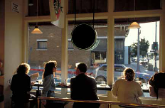
Section 1.1
STOP!
1.1
Chapter 1 | Welcome to the Restaurant and Foodservice Industry

Slide 20
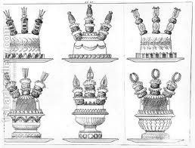
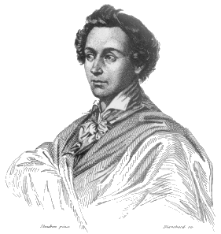
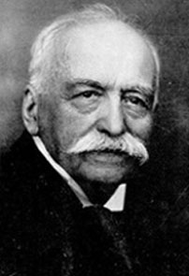
Great Chefs
Careme (1784-1833)
  Defined the art of grand cuisine
    Elaborate pieces montees
      Masterpieces of elaborate decorative art
  Founder of the Mother Sauces
Escoffier (1846-1935)
  “King of the Kitchen”
  Credited with refining Careme’s grand cuisine into the more contemporary classical cuisine
  Founder of the kitchen brigade system
    Assigns certain responsibilities to kitchen staff

Slide 21
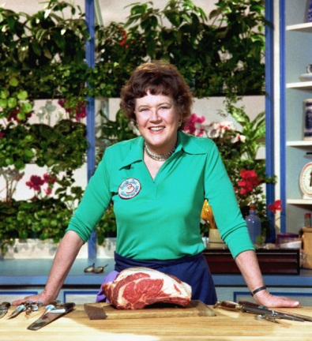
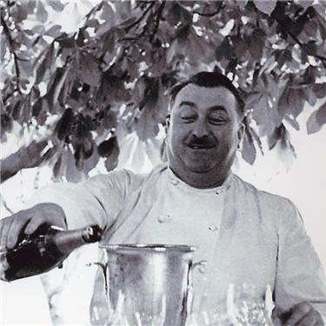


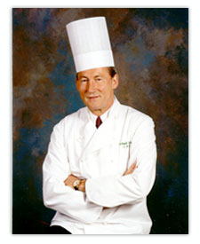
Chefs Of the 20th Century
Fernand Point (1897-1955)
  Father of Modern cuisine
    Lighter sauces and regional ingredients
Julia Child (1912-2004)
  Popularizing French cuisines and techniques
    Mastering the Art of French Cooking
Paul Bocuse (1926-)
  Taught by F. Point, continued to make lighter, healthier dishes with classical French flavor
Alice Waters (1944-)
  Provide dishes use only seasonal, local products at the height of freshness
    Chez Panisse
Ferinand Metz (1941-)
  Certified Master Chef who served as president of Culinary Institute of America (CIA)
  Won 2 gold medals with the US Culinary Olympic Team

Slide 22
Types of Establishments
There are many establishments providing foodservice opportunities within the travel and tourism industry.
Restaurants
  prepare and serve meals to customers.
    These types of business opportunities are available in restaurants.
      Corporate restaurant groups
      Chains
      Franchisee/franchisor
      Independents/entrepreneurs
1.2
Chapter 1 | Welcome to the Restaurant and Foodservice Industry

Slide 23

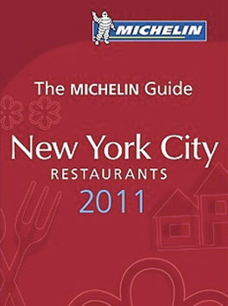
Types of Establishments (cont.)
Many customers look to organizations that review establishments and post ratings to decide where to dine.
  The Zagat Survey
    a consumer-based guide that rates restaurants on four qualities: food, décor, service, and cost.
    Zagats--Adam Sandler and Chris Farley
  The Michelin Guide
    a rating system best known in Europe.
    Restaurants are rated from one to three stars.

Slide 24
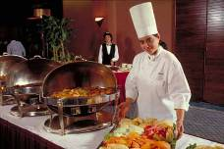
Types of Establishments (cont.)
Catering
  provides opportunity for creativity in menu selection and style of service.
  provide foodservice for everything from special events in private homes to large-scale events such as golf tournaments, weddings, or corporate dinners.
    can be found in catering departments within hotels, independent catering companies, and restaurants.
1.2
Chapter 1 | Welcome to the Restaurant and Foodservice Industry

Slide 25
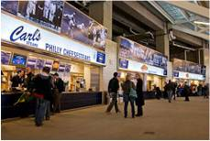
Types of Establishments (cont.)
Retail foodservice opportunities are found in businesses that offer home meal replacements and ready-made dishes.
At stadiums or sports arenas, tens of thousands of people with foodservice needs want service in a relatively small period of time.
  Foodservice is provided by servers, walking vendors, cooks, and cashiers.
  Stadiums also have corporate suites that offer superior service and food.
    Stadiums typically have contract feeders, a unique venue with managers who specialize in managing stadium events.
1.2
Chapter 1 | Welcome to the Restaurant and Foodservice Industry

Slide 26

Types of Establishments (cont.)
Convention centers are specifically designed to house large-scale special events such as conventions, expositions, and trade shows.
A convention is a gathering of people, all of whom have something in common.
  Democratic Convention in Charlotte 2012
Expositions are large shows, open to the public, that highlight a particular type of product or service.
  Pet Expo in Hickory
While expositions are open to the general public, trade shows are restricted to those involved in the industry being featured.
  Food Shows
A convention, exposition, or trade show can have a major impact on the local economy of its host city.
  People attending these events eat in the city’s restaurants, shop in its stores, and stay in its hotels.
    These events are good sources of jobs in catering, customer service, and contract foodservice.
1.2
Chapter 1 | Welcome to the Restaurant and Foodservice Industry

Slide 27
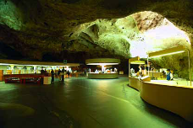
Types of Establishments (cont.)
The national park system is operated by the National Park Service, which is part of the U.S. Department of the Interior.
Many people make national or state parks their travel destination.
In addition to parks, the national park system includes recreation areas, former battlefields, and other historic sites, monuments, and memorials.
Many parks offer high-quality accommodations, ranging from campgrounds to hotels, as well as a wide variety of restaurants.
Most of the guest facilities in national parks are managed by private companies.
1.2
Chapter 1 | Welcome to the Restaurant and Foodservice Industry

Slide 28
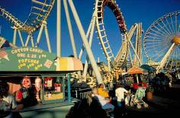
Types of Establishments (cont.)
Modern theme parks offer a full array of entertainment features that create an overall atmosphere of fun.
The popularity of theme parks as tourist destinations has had a major affect on all hospitality industries.
Quality of food and service is very important in this setting, as food is a major part of the guests’ experience.
  Dishes can be matched to the theme of the park, and the venue’s design might also contribute to the larger theme.
    Dollywood’s 10# apple pie
Today, many theme parks worldwide offer a variety of foodservice options.
  National quick-service chains are common sights at theme parks.
1.2
Chapter 1 | Welcome to the Restaurant and Foodservice Industry

Slide 29
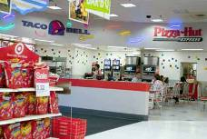
Types of Establishments (cont.)
In recent years, shopping areas have become a major destination for travelers in the United States and other countries.
Some people flock to shopping centers to look for bargains, while others find shopping itself an enjoyable activity.
Shopping malls and plazas offer a variety of foodservice opportunities, including quick-service and casual-dining restaurants.
  Food Court at the Valley Hills Mall
  Subway in Wal-Mart
Outlet centers attract travelers from far away, generating income for the foodservice and hospitality businesses in the nearby community.
Department stores are a major segment of the retail industry.
  Foodservice opportunities in these stores include cafes, cafeterias, and full-service restaurants.
Large discount chains form another segment of the retail industry.
  Cafeteria-style and quick-service operations are popular additions to these stores.
1.2
Chapter 1 | Welcome to the Restaurant and Foodservice Industry

Slide 30

Types of Establishments (cont.)
Monuments are typically either structures built to memorialize something or someone, or structures recognized for their historical significance.
  Concessions, restaurants within the monuments or associated with them, are common foodservice opportunities.
Zoos offer a wide range of foodservice options, including concessions, fine dining, and casual dining.
The growing need for health-care services is likewise bringing about growth in foodservice opportunities in hospitals, long-term care facilities, and assisted-living facilities.
  Foodservice in health-care facilities requires special attention to the dietary needs of patients.
1.2
Chapter 1 | Welcome to the Restaurant and Foodservice Industry

Slide 31

Types of Establishments (cont.)
Schools and universities often use satellite, or commissary feeding, which is when one kitchen prepares food that is then shipped to other locations to be served.
Foodservice opportunities in the military are greater now than ever. More than a million meals are prepared in military kitchens each day.
Food is critical to maintaining a positive and peaceful atmosphere in correctional facilities. Well-prepared food at minimal cost is the challenge.
There is a wide range of foodservice opportunities in the lodging industry
  From luxury hotels with award-winning, fine-dining operations to discount chains offering breakfasts to travelers.
1.2
Chapter 1 | Welcome to the Restaurant and Foodservice Industry

Slide 32

Career Pathways
There are many career opportunities in the hospitality industry, including positions for both front-of-the-house and back-of-the-house.
Front-of-the-house
  Employees serve guests directly.
    These positions include managers, assistant managers, banquet managers, dining room managers, hosts/ hostesses, cashiers, bar staff, serving staff, and busers.
Back-of-the-house
  Employees work outside the public space.
    These positions include chefs, line cooks, pastry chefs, dishwashers, bookkeepers, storeroom clerks, purchasers, dietitians, and menu planners.
An entry-level job
  One that requires little or no previous experience.
    Such jobs are an important starting point in any career. Entry-level jobs usually lead to other positions with more responsibility.
1.2
Chapter 1 | Welcome to the Restaurant and Foodservice Industry

Slide 33
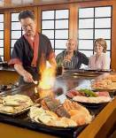
Section 1.2 Summary
Stop!
1.2
Chapter 1 | Welcome to the Restaurant and Foodservice Industry

Slide 34

Why People Travel
Leisure travelers
  Go to a place for relaxation, entertainment, education, adventure and sport, and social and family events.
Business travelers
  Go to a specific place for the purposes of sales, negotiations, training, or other types of business related to their jobs.
    Business travelers represent the majority of guests for most lodging establishments.
1.3
Chapter 1 | Welcome to the Restaurant and Foodservice Industry

Slide 35

Why People Travel (cont.)
To meet the needs of both leisure and business travelers, tourism is classified according to the type of travel experience that people desire.
Cultural tourists
  Visit other lands to observe, learn about, and live among people whose cultures are different from their own.
    Spain or Italy
Environmental tourists
  Visit places in order to enjoy their natural beauty.
    These tourists often enjoy photography, hiking, biking, mountain climbing, camping, and canoeing.
Recreational tourists
  Usually look for places where they can swim, lie in the sun, ski, play golf or tennis, see shows, and so on.
    Myrtle Beach
1.3
Chapter 1 | Welcome to the Restaurant and Foodservice Industry

Slide 36
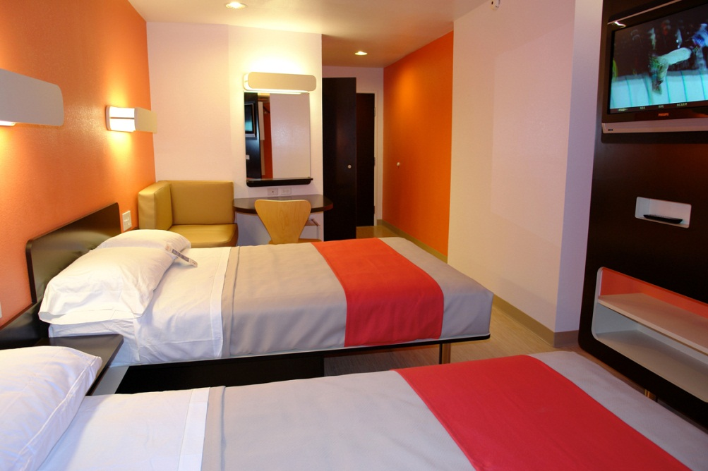
Types of
Lodging Operations
Lodging properties are classified by the level of service provided, the rates charged, the amenities offered, or any combination of these or other factors.
Luxury properties are hotels that offer top-of-the-line comfort and elegance.
  Luxury Hotels in Paris
Full-service properties cater to travelers in search of a wide range of conveniences.
Economy lodging offers clean, low-priced lodging to traveling salespeople, senior citizens, and families with modest incomes.
1.3
Chapter 1 | Welcome to the Restaurant and Foodservice Industry

Slide 37
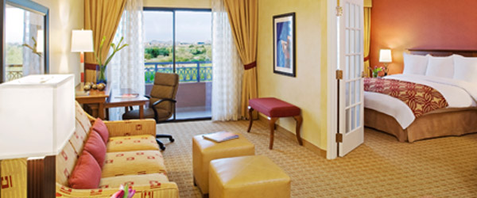
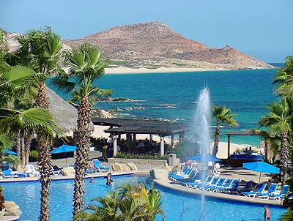
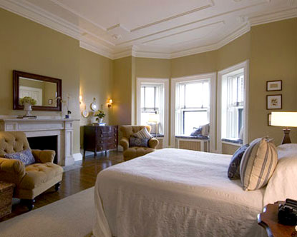
Types of
Lodging Operations
All-suite properties offer apartment-style facilities.
Resorts feature extensive facilities for vacationers who are looking for recreational activities and entertainment.
Bed and breakfasts cater to guests looking for quaint, quiet accommodations with simple amenities.

Slide 38
Ratings Organizations
To distinguish one lodging property from another, several organizations rate the quality of lodging establishments.
The American Automobile Association’s (AAA) Tour Book is the most widely recognized rating service in the United States.
The Tour Book uses a diamond system in judging overall quality:
  Functional accommodations that comply with minimum standards; meet basic needs of comfort, privacy, cleanliness, and safety.
  Noticeable enhancements over properties in terms of decor and/or quality of furnishings.
  Marked upgrade in services and comfort, with additional amenities and/or facilities.
  Excellent properties offering a high level of service and a wide variety of amenities and upscale facilities.
  Exceptional establishments providing the highest level of luxury and service.
1.3
Chapter 1 | Welcome to the Restaurant and Foodservice Industry

Slide 39
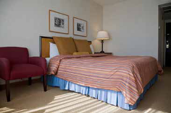
Lodging Careers
Careers in the lodging industry are typically divided into those with customer contact and those that support the running of the operation.
Customer contact positions include front office, food and beverage, or concierge.
The front office has four main responsibilities:
  Check-in
  Reservations
  Information
  Checkout
Behind-the-scenes positions include housekeeping, accounting and financial, security, engineering, and facility management.
1.3
Chapter 1 | Welcome to the Restaurant and Foodservice Industry

Slide 40
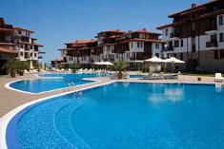
Section 1.3 Summary
STOP!
1.3
Chapter 1 | Welcome to the Restaurant and Foodservice Industry

