Slide 1
As Purchased and Edible Portion
A pictorial guide to the formula

Slide 2
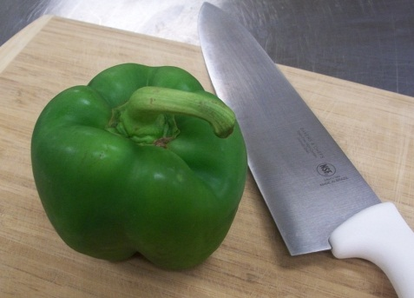
This is a green pepper.
Currently its state (the condition that it is in) is …
As Purchased

Slide 3
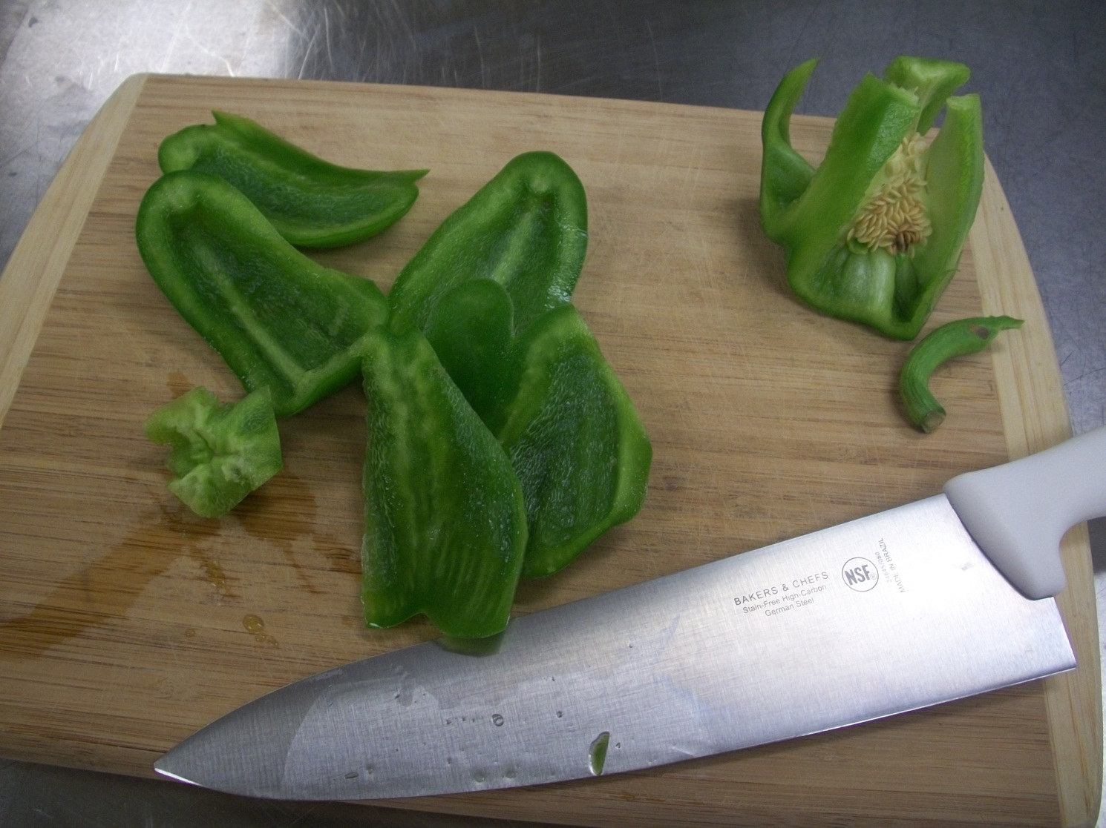
This is the same green pepper. Its state (the condition that it is in) has changed.
It has now been divided into Edible Portion and waste.
EDIBLE PORTION
(82%)
WASTE
(18%)

Slide 4
Why you need the formula
You can physically measure edible portion from as purchased products – but …
It takes a long time.
It doesn’t help you make your shopping list or your supply order for the banquet you are catering.
So smart people in kitchens have figured it out already and devised a handy formula to help you figure out how many green peppers to buy to get 1 pound of EP green pepper for your recipe.

Slide 5
The formula
To calculate As Purchased amount to buy, use this formula:
AP = EP ÷ Yield Percentage
The yield percentage should be expressed as a decimal.
This gives you the AP amount.
You get the yield percentage from the chart in the textbook or from a source like “The Book of Yields.”
(Yes, someone has written a book about EP and AP with the Yield Percentage for many common restaurant ingredients listed in charts.)

Slide 6
To reverse it
To calculate how much EP you will get from an AP amount, you reverse the formula.
EP = AP * Yield Percent (expressed as a decimal)

